Slide 1
Functional Testing

Slide 2
TDD isn’t limited to unit testing

Slide 3
BDD
Behavior-driven development
Notes:
We want the application to do something. The application doesn’t store some strings in a hashmap - the code does that. The application helps users perform some task.

Slide 4
Acceptance
Allow blog owner to create a new post

Slide 5
missing UI elements
Acceptance
Allow blog owner to create a new post

Slide 6
missing UI elements
Acceptance
Modify the view
Allow blog owner to create a new post

Slide 7
missing UI elements
Acceptance
Modify the view
Allow blog owner to create a new post
missing controller action

Slide 8
missing UI elements
Acceptance
Modify the view
Allow blog owner to create a new post
missing controller action
Create and display post for owner
Unit

Slide 9
missing UI elements
Acceptance
Modify the view
Allow blog owner to create a new post
missing controller action
Create and display post for owner
Unit

Slide 10
missing UI elements
Acceptance
Modify the view
Allow blog owner to create a new post
missing controller action
Create and display post for owner
Unit
missing repository implementation

Slide 11
missing UI elements
Acceptance
Modify the view
Allow blog owner to create a new post
missing controller action
Create and display post for owner
Unit
missing repository implementation
Persist new post
Integration

Slide 12
missing UI elements
Acceptance
Modify the view
Allow blog owner to create a new post
missing controller action
Create and display post for owner
Unit
missing repository implementation
Persist new post
Integration

Slide 13
missing UI elements
Acceptance
Modify the view
Allow blog owner to create a new post
missing controller action
Create and display post for owner
Unit
missing repository implementation
Persist new post
Integration
missing UI elements

Slide 14
missing UI elements
Acceptance
Modify the view
Allow blog owner to create a new post
missing controller action
Create and display post for owner
Unit
missing repository implementation
Persist new post
Integration
missing UI elements
Modify the view

Slide 15
missing UI elements
Acceptance
Modify the view
Allow blog owner to create a new post
missing controller action
Create and display post for owner
Unit
missing repository implementation
Persist new post
Integration
missing UI elements
Modify the view
Acceptance test green

Slide 16
What is Functional Testing?
Answers the question of "can the user do this" or "does this particular feature work”
Business-facing, product-facing tests
Tests that prove you “built the right thing” (as opposed to “built the thing right”)
Notes:
AKA Story tests, customer tests
End-to-end testing (i.e., does the application work all the way through)
Regression tests that reflect a particular defect found in production
Testing "from a user perspective", which includes acceptance tests
Acceptance testing is particularly relevant in Agile
Guarantees that the requirement as specified is implemented in the software
Some teams use Acceptance test driven development
All functional tests are not acceptance tests however

Slide 17
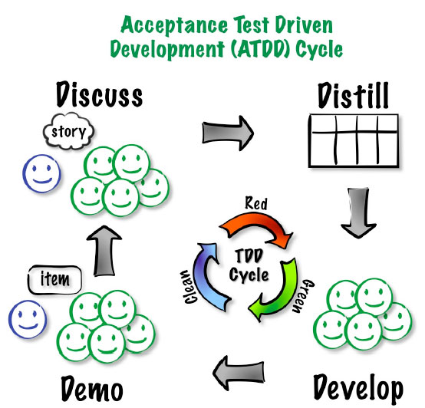
Functional Testing
Automating Functional Tests
Functional Test Automation Makes Testing an Asset
Living documentation
Why Functional Test Automation?
Unit Testing is Fundamentally Different
Automated Testing Has Additional "Gotchas"
Notes:
Answers important strategic questions:
How can tests be executed early and often enough to mitigate risk?
How can tests be maintained as long-lived, evolving, and reusable assets?
How can testing involve all the stakeholders in the software development process such that requirements are fully understood and tested?
How can the highest value most essential testing be identified?
Functional test automation is not an end unto itself – it’s a tool and a capability
Automation does a few things very well:
Makes regressions run faster, freeing testers up to think, not click
Allows for running tests in different environments and on different platforms
Shores up the safety net
Extends your capacity to cover different testing models
Gives fast feedback to teams
Reduces the defects that make it to production by providing frequent regression checks
Makes requirements clearer by giving developers executable acceptance tests
Automation does not:
Find all of the bugs a user might encounter
Find logical inconsistencies, performance, security or UX problems in the application
Cover all boundary conditions, particularly at higher levels
Many organizations believe that unit tests are a panacea for software quality
Unit tests are good at a few things:
Preserving developer intention
Helping developers design code better
Helping developers think through boundary conditions
Unit tests aren’t good at:
Checking integration between components
Validating that software works from a user perspective
Finding unanticipated errors
Covering all boundary conditions
Brittleness
Maintainability
Time Required
Not inherently collaborative

Slide 18
Building a testing pyramid
How much?
What should we automate vs. leave manual?
Which tools?
When in the development cycle?
Who does the automation?
What mix of testing makes sense?
End-to-end tests
System tests
Functional tests
Component/integration tests
Unit tests
Notes:
Answers important strategic questions:
How can tests be executed early and often enough to mitigate risk?
How can tests be maintained as long-lived, evolving, and reusable assets?
How can testing involve all the stakeholders in the software development process such that requirements are fully understood and tested?
How can the highest value most essential testing be identified?
Functional test automation is not an end unto itself – it’s a tool and a capability
Automation does a few things very well:
Makes regressions run faster, freeing testers up to think, not click
Allows for running tests in different environments and on different platforms
Shores up the safety net
Extends your capacity to cover different testing models
Gives fast feedback to teams
Reduces the defects that make it to production by providing frequent regression checks
Makes requirements clearer by giving developers executable acceptance tests
Automation does not:
Find all of the bugs a user might encounter
Find logical inconsistencies, performance, security or UX problems in the application
Cover all boundary conditions, particularly at higher levels
Brittleness
Maintainability
Time Required
Not inherently collaborative
In order to ensure the quality of your application, it is important to build up good test coverage with different types of testing
In order to ensure the quality of your application it is important to build up good test coverage at each of the levels below
Unit tests
Ensure good code quality
Acceptance tests
Ensure that the functionality is implemented correctly
Automated functional tests
Ensure functionality does not regress
Exploratory tests
Used to track down difficult conceptualise test cases
End to end integration tests
Ensure the system works as a whole
Non Functional tests
Ensure that system meets non functional requirements such as performance and security

Slide 19
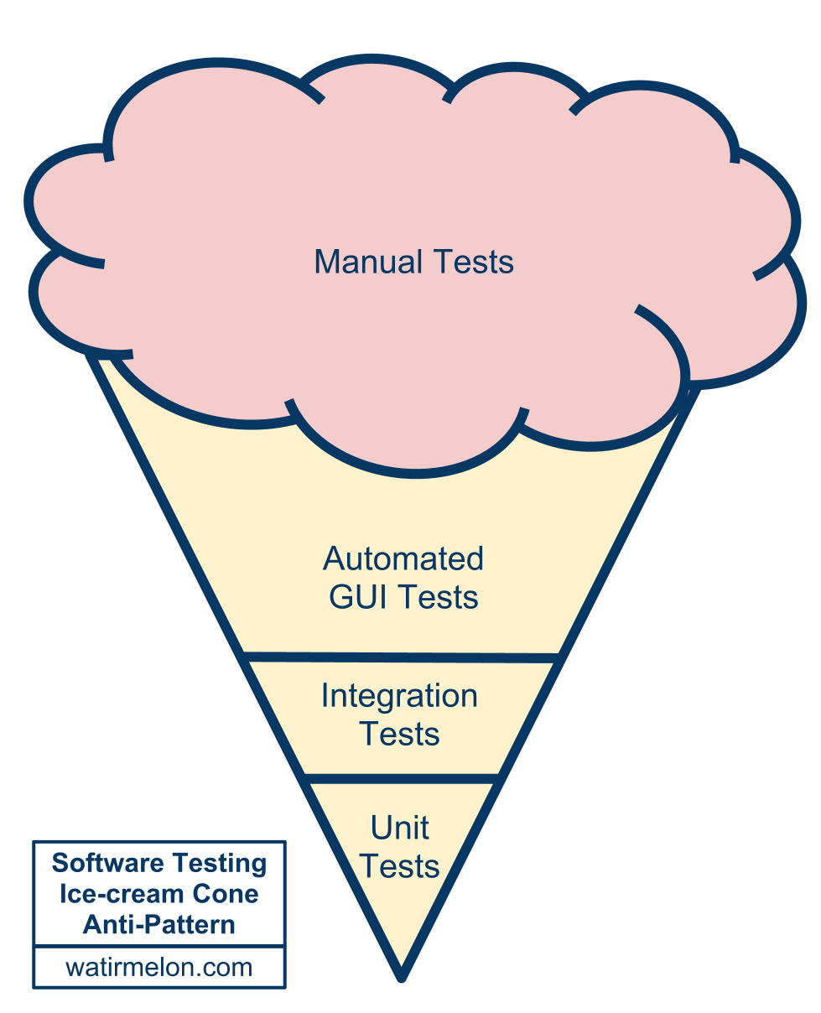
Alister Scott’s testing anti-pattern
Notes:
Alister is a ThoughtWorker in Brisbane, Australia.

Slide 20
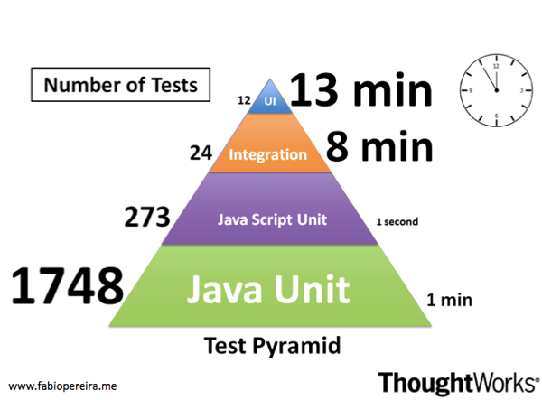
Testing pyramid: Example
Notes:
Test automation is prevalent in the software development community. Practices like TDD and BDD are widespread and applied almost unquestionably. However, several organisations have struggled in attempting to scale automated test suites, which very often become slow, brittle, non-deterministic, unreliable and difficult to maintain.
One common issue reported by many teams and that I have also experienced many times is the inverted testing pyramid.
A year ago I joined a project that was going in that direction. I could see us making the same mistakes again. If we had kept going we would have ended up with the slow and hard to maintain, melting ice-cream cone. However, this time we tried a different approach. Our strategy was to test the code as close as possible to where it was written using preferably either unit or integration tests. We only automated high level test journeys at the UI level.
Now, one year later, we have a stable and fast build, which gives us an extremely high level of confidence.
Some observations:
Only 12 tests through the UI take 13 minutes to run
1748 unit tests take only 1 minute
273 JavaScript unit tests take less than 1 second. Treating JS as a 1st class language helped us as well

Slide 21
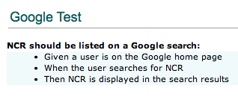
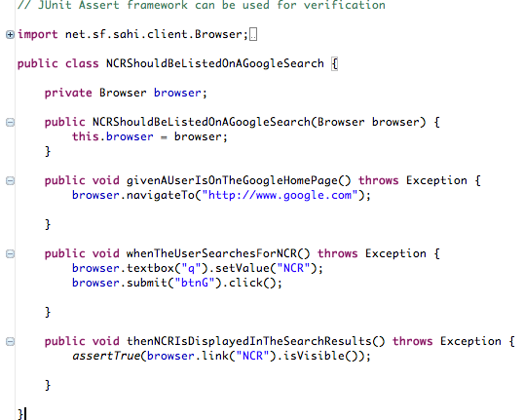
Functional test example

Slide 22
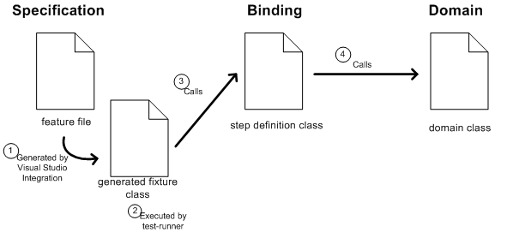
Functional Testing
Behavior-driven development frameworks
Notes:
Answers important strategic questions:
How can tests be executed early and often enough to mitigate risk?
How can tests be maintained as long-lived, evolving, and reusable assets?
How can testing involve all the stakeholders in the software development process such that requirements are fully understood and tested?
How can the highest value most essential testing be identified?
Functional test automation is not an end unto itself – it’s a tool and a capability
Automation does a few things very well:
Makes regressions run faster, freeing testers up to think, not click
Allows for running tests in different environments and on different platforms
Shores up the safety net
Extends your capacity to cover different testing models
Gives fast feedback to teams
Reduces the defects that make it to production by providing frequent regression checks
Makes requirements clearer by giving developers executable acceptance tests
Automation does not:
Find all of the bugs a user might encounter
Find logical inconsistencies, performance, security or UX problems in the application
Cover all boundary conditions, particularly at higher levels
Many organizations believe that unit tests are a panacea for software quality
Unit tests are good at a few things:
Preserving developer intention
Helping developers design code better
Helping developers think through boundary conditions
Unit tests aren’t good at:
Checking integration between components
Validating that software works from a user perspective
Finding unanticipated errors
Covering all boundary conditions
Brittleness
Maintainability
Time Required
Not inherently collaborative

Slide 23
Review: The iteration
Daily stand-up
Release backlog
Prioritized subset
Release planning
Pre-iteration planning/
backlog grooming
Iteration planning/ kickoff
Showcase + Retrospective
Working software
Notes:
Story Backlog
List of stories for the entire project
Prioritized sub set
Prioritized for the next Iteration
Whole team
IPM
No waste
IKO
Clarify
Task
Estimate
Stand up
Short
Yesterday, today, blockers
Chickens and pigs
Showcases
Present working software
Sometimes give customer a play environment too
Customer gives feedback
New stories?
Re-plan?
Retrospective
Well, not so well
Constant improvement

Slide 24
Detail is commensurate with plan horizon
Themes
Epics
Stories
Tasks
Home Page
Search Results
Full Page Ad
Featured Listing
Search Form
Classified Results
Billing
Dealer Groups
Display Logic
Click Counting
Matching Search Criteria
Choosing a Dealer
Choosing an Ad
Etc…

Slide 25
Elicit detail just in time

Slide 26
Story attributes
INVEST
3 C’s

Slide 27

Writing acceptance criteria
Collaborative
How will you know when we’re finished?
Multiples per story
All or nothing
Notes:
Use the Wisdom of Crowds approach to defining.
Diverse set of independent individuals
Maximise the effectiveness of decision making process
BA, Biz, Devs, QA all participate in defining the acceptance criteria
----------------------------------------------------------------------------------------------------------------------------------------
If you have attended the Leadership or Project Management training, you will recall the concept of Collective Wisdom, or Wisdom of the Crowds. In short, collective wisdom demands the use of a large, diverse set of independent individuals to maximise the effectiveness of decision making processes. This same approach should be considered for acceptance criteria in order to obtain the best coverage of criteria across the requirement. Developers, analysts, architects and testers should all be able to provide useful input to generating acceptance criteria.
If you don’t have any background information on these topics, try http://en.wikipedia.org/wiki/Collective_wisdom or http://en.wikipedia.org/wiki/The_Wisdom_of_Crowds .
REMOVED
Derived with the customer and someone technical to provide feasibility
Ask the customer: What will you observe when the story is successfully complete?
Use Wisdom of Crowds
Most stories will generate multiple criteria
All must be met before the story can be completed
Consider using a template

Slide 28
Acceptance criteria
Given <context>
When <action>
Then <expectation>

Slide 29
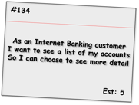
Acceptance criteria examples
Given the customer has one transaction account and one credit account
When they have completed logging in
Then the screen should show the names and numbers of the two accounts sorted in account number order
Given the customer has just one transaction account
When they have completed logging in
Then the screen should show the name and number of the account
Given the customer has no accounts
When they have completed logging in
Then the screen should show a message stating that no accounts are available
Given the customer has more than 20 accounts
When they have completed logging in
Then the screen should show the first 20 accounts (in account number order) only
Given the customer has some accounts
When they have completed logging in
And the system cannot retrieve the account details
Then the screen should show an error message with associated code and details to contact for support
Alternate path
Alternate path
Bad path
Notes:
This format is iteration level acceptance criteria vs. Inception level.
Shows positive, alternate and bad paths.
Talk through each one.
-----------------------------------------------------------------------
Here we see a set of criteria for an Internet Banking story covering a range of positive, alternate and bad paths through the requirement. As is expected, the positive paths map directly to the requirements as stated and assume everything is working as expected.
The alternate path criteria describe non-standard ways to meet the desired outcome, which although may not be considered within the narrative of the story, are still reasonable to assume as usage patterns for the system.
Bad path criteria describe situations in which the outcome cannot be achieved, in this case how the system would behave in the case of an internal error.

Slide 30
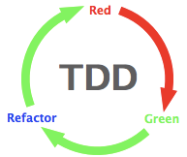
Driving with acceptance tests
- ATDD image from Elisabeth Hendrickson
Notes:
Answers important strategic questions:
How can tests be executed early and often enough to mitigate risk?
How can tests be maintained as long-lived, evolving, and reusable assets?
How can testing involve all the stakeholders in the software development process such that requirements are fully understood and tested?
How can the highest value most essential testing be identified?
Functional test automation is not an end unto itself – it’s a tool and a capability
Automation does a few things very well:
Makes regressions run faster, freeing testers up to think, not click
Allows for running tests in different environments and on different platforms
Shores up the safety net
Extends your capacity to cover different testing models
Gives fast feedback to teams
Reduces the defects that make it to production by providing frequent regression checks
Makes requirements clearer by giving developers executable acceptance tests
Automation does not:
Find all of the bugs a user might encounter
Find logical inconsistencies, performance, security or UX problems in the application
Cover all boundary conditions, particularly at higher levels
Many organizations believe that unit tests are a panacea for software quality
Unit tests are good at a few things:
Preserving developer intention
Helping developers design code better
Helping developers think through boundary conditions
Unit tests aren’t good at:
Checking integration between components
Validating that software works from a user perspective
Finding unanticipated errors
Covering all boundary conditions
Brittleness
Maintainability
Time Required
Not inherently collaborative

Slide 31
ATDD cycle

Slide 32
ATDD cycle

Slide 33
ATDD cycle

Slide 34
ATDD cycle

Slide 35
ATDD cycle

Slide 36
ATDD cycle

Slide 37
Proven practices for test development
Separate intent from implementation (mechanics)
Test automation best practices = programming best practices:
Abstraction
Encapsulation
Refactoring
Don’t repeat yourself
Notes:
Abstraction: hide implementation details
Encapsulation: all of the object's data is contained and hidden in the object and access to it restricted to members of that class.

Slide 38
Proven practices for scenarios
Think (and specify) from the business perspective
Write tests for reusability
Refactor steps
Extract steps as you go
Rule of thumb for workflow – not more than 10 steps
Limit verifications and assertions in extracted steps
Notes:
describe a bit about user journeys: The statement about scripts having no more than 10 steps is good for acceptance tests, I'm thinking about the UAT/User Journey/E2E ones and whether it's worth having some description about them included
Concept
Logged in as admin
Go to login page
Type admin/admin
****
Tests
Call Logged in as admin
Asset: On x page/

Slide 39
Challenges
Unstable Tests
Page synchronization
Waits
Data dependencies
Side-effects from tests
Order/group execution problems
UI changes
Unclear Tests
Too many asserts
Test duplication
Unnecessary/duplicated setup
Notes:
Waits – don’t poll, go event based, use an explicit wait (selenium page model)
UI Changes
Xpath is difficult to maintain Avoid using xpaths
ID change Create constant IDs & reuse

Slide 40
Story
As a content provider
I want to have a promotion where every three-day rental gets an extra day for children’s releases
So that I can encourage longer rentals

